Slide 1
205 Nov 1, Class 16
Non-experimental designs
  Correlation
  Observational design
Final project planning
  Group updates

Slide 2
Experiment 1 feedback
N=37
  My fault for those who got this wrong as I made an error on the class slides
    (but you could have noticed from the df and condition n’s…)
Follow the provided guidelines
  Chapter 6
  Posted sample paper
    Manuscript format
  Background research papers & final project readings
    For content style

Slide 3
Intervention research in child development has repeatedly produced a paradoxical conclusion: In correlational studies, parental assistance with children’s homework has been associated with lower academic achievement. As a result, some psychologists have concluded in published reports that parents should not help their children with homework…

Slide 4
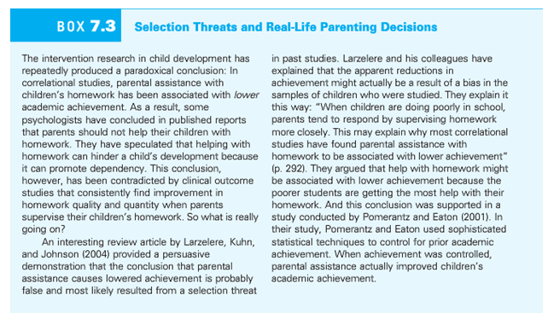

Slide 5
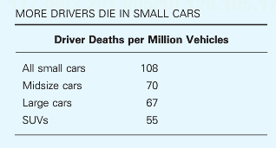
Multiple accounts consistent with the data
Large cars are safer than small cars
  Small cars are more dangerous than large cars
Safest cars: Acura RX SUV, Acura RL sedan, Audi 4
Most dangerous cars: Chevy Cobalt, Ford Focus, Mazda 3

Slide 6
Validity
Q1. Why are experimental studies higher in internal validity?
Q2. Why are nonexperimental studies higher in external validity?

Slide 7
Correlations
For each of the following statistical relationships, decide whether the directionality problem is present and think of at least one plausible third variable.
3a. People who eat more lobster tend to live longer.
3b. People who exercise more tend to weigh less.
3c. College students who drink more alcohol tend to have poorer grades.

Slide 8
Causality
If variables X & Y are very strongly correlated, does X cause Y?
Correlation between X & Y means either
  X causes Y
  Y causes X
  Z causes both X and Y

Slide 9
Variables observed to co-vary
  Hot weather is associated with higher rates of street violence
  Older people exercise less than middle aged people
  A college education increases people’s SAT scores

Slide 10
Famous Non-experimental Psychology Studies
Stanley Milgram found that about two thirds of his research participants were willing to administer dangerous shocks to another person just because they were told to by an authority figure (Milgram, 1963).
Elizabeth Loftus and Jacqueline Pickrell showed that it is relatively easy to “implant” false memories in people by repeatedly asking them about childhood events that did not actually happen to them (Loftus & Pickrell, 1995).

Slide 11
Non-experimental designs
Collected in the real world outside the laboratory
  Observation
  Surveys
  Qualitative research
  Intervention research
Lack of control = less internal validity
  As little as none in some cases
Collecting data in context = greater external validity
  Little concern about applying outside the lab

Slide 12
Final project status
Groups
  Project ideas

Slide 13
For Mon Nov 3
Read Plant et al. (2009), The Obama Effect
Chapter 15: Surveys

